Slide 1
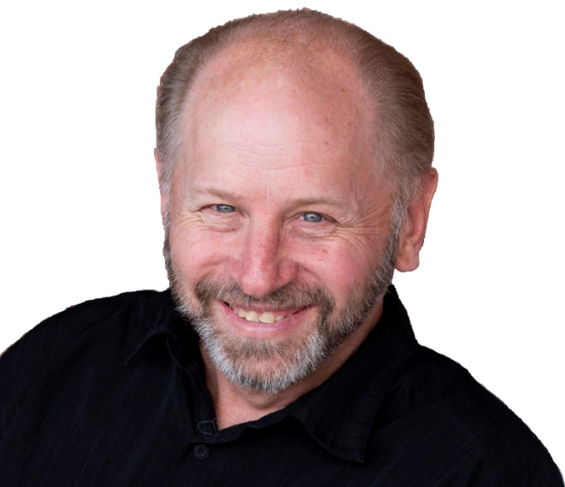
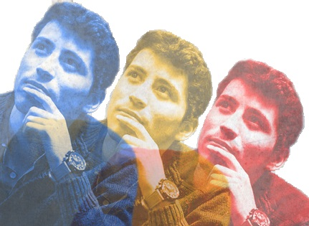
With
Rick McGough
PART 8

Slide 2
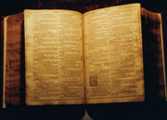
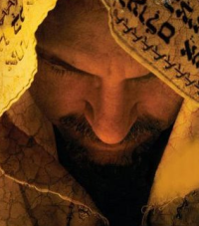
Faith & Reason Made Simple
(Part 8)
The Person of
Jesus Christ (Cont.)

Slide 3
The Person of
Jesus Christ
Jesus Is The Christ
(Messiah)

Slide 4
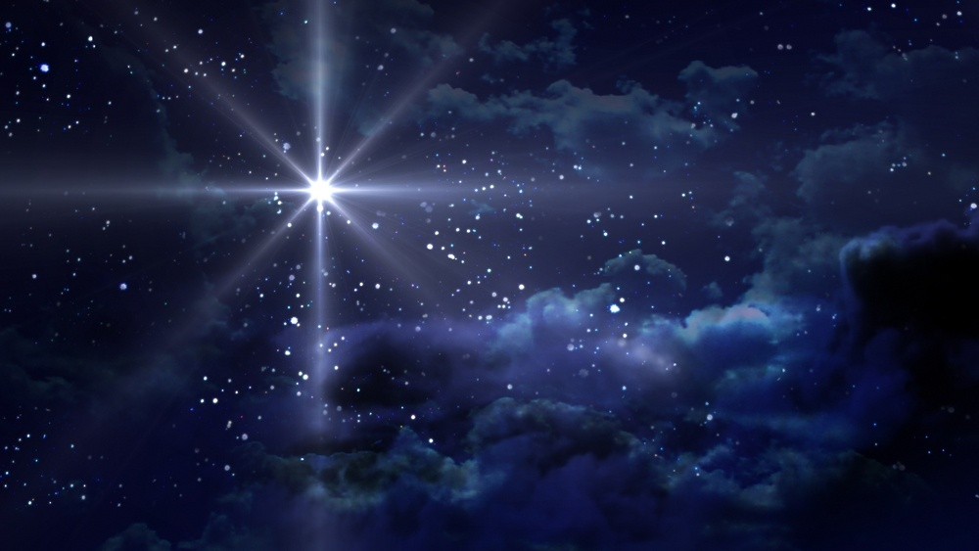
Jesus Is The Christ (Messiah)
John 20:30-31 NASB Therefore many other signs Jesus also performed in the presence of the disciples, which are not written in this book; (31) but these have been written so that you may believe that Jesus is the Christ, the Son of God; and that believing you may have life in His name.

Slide 5
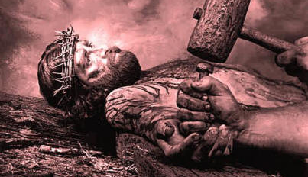
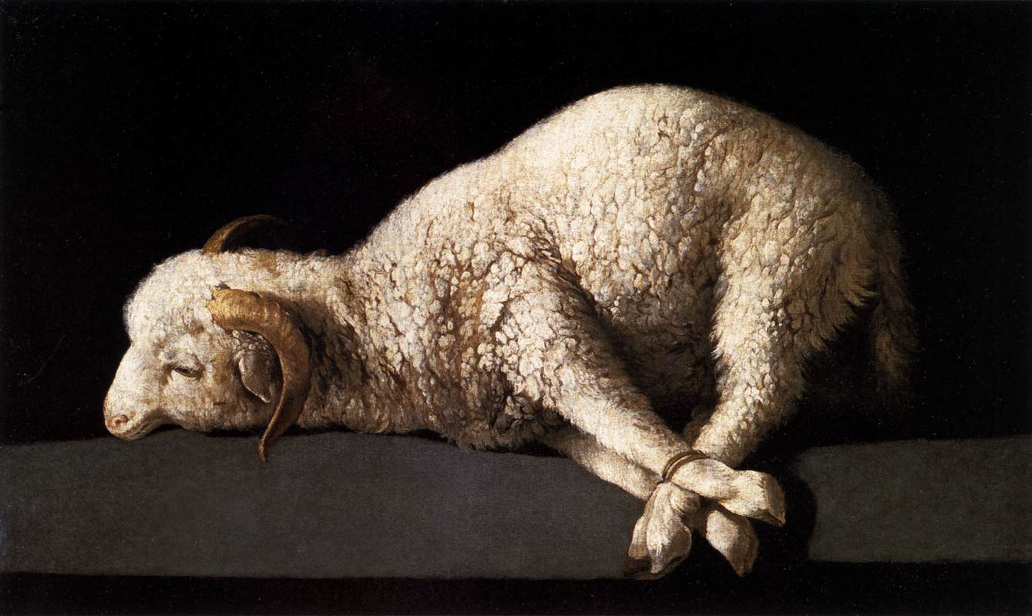
The Suffering Messiah (Christ)
Psalm 22
Isaiah 53
Passover Lamb
(Ex. 12) (1 Cor. 5:7)

Slide 6
Jesus Is The Christ (Messiah)
Daniel 7:13 NASB "I kept looking in the night visions, And behold, with the clouds of heaven One like a Son of Man was coming, And He came up to the Ancient of Days and was presented before Him.”

Slide 7
Jesus Is The Christ (Messiah)
Daniel 7:14 "And to Him was given dominion, glory and a kingdom, That all the peoples, nations and men of every language might serve Him. His dominion is an everlasting dominion Which will not pass away; And His kingdom is one which will not be destroyed.

Slide 8
Jesus Is The Christ (Messiah)
Jesus is Referred to “Son of Man”
(85 Times in the Gospels & Acts)
Matthew (31xs) - Mark (14xs)
Luke (26xs) - John (13xs)
Important to Remember “Son of Man” Refers to the Messiah

Slide 9
Jesus Is The Christ (Messiah)
Mark 14:62 NASB And Jesus said, "I am; and you shall see THE SON OF MAN SITTING AT THE RIGHT HAND OF POWER, and COMING WITH THE CLOUDS OF HEAVEN."

Slide 10
Jesus Is The Christ (Messiah)
Acts 7:55-56 NASB But being full of the Holy Spirit, he gazed intently into heaven and saw the glory of God, and Jesus standing at the right hand of God; (56) and he said, "Behold, I see the heavens opened up and the Son of Man standing at the right hand of God."

Slide 11
Jesus Is The Christ (Messiah)
Matthew 24:30 NASB "And then the sign of the Son of Man will appear in the sky, and then all the tribes of the earth will mourn, and they will see the SON OF MAN COMING ON THE CLOUDS OF THE SKY with power and great glory.

Slide 12
Jesus Is The Messiah (The Christ)
Over 300 Messianic Prophecies Fulfilled by Jesus Christ
* Isaiah 7:14, Isaiah 9:6-7,
Micah 5:2 (Birth)
* Isaiah 53, Psalm 22 (Cross)
* Psalm 78:2 (Parables)
* Zechariah 9:9 (Donkey)
* Zechariah 11:12-13 (Silver)
* Psalm 22:18 (Garments)

Slide 13
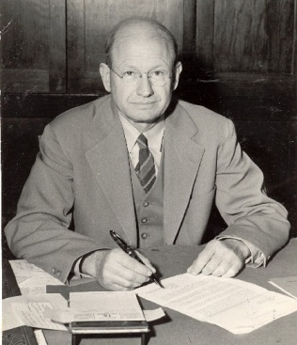
Over 300 Prophecies Fulfilled by Jesus Christ
Mathematical Probability
(Fulfilling Just 8
of These Prophecies)
28
1 in 10
Dr. Peter Stoner
10,000,000,000,000,000,000,000,000,000

Slide 14
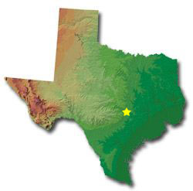
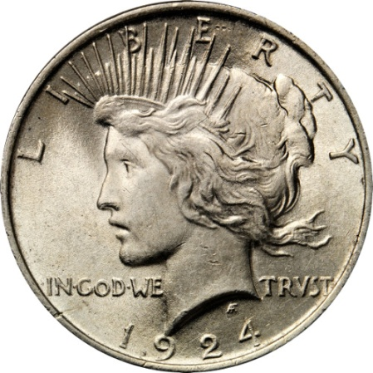
State of Texas
Cover with Silver
Dollars (2 Feet)
State of Texas
Silver Dollars – 2 Feet Layer
Mark One & Have a Blind Person Pick
it Randomly

Slide 15
State of Texas
Cover with Silver
Dollars (2 Feet)
State of Texas
Silver Dollars – 2 Feet Layer
Mark One & Have a Blind Person Pick
it Randomly
Mark One

Slide 16
State of Texas
Cover with Silver
Dollars (2 Feet)
State of Texas
Silver Dollars – 2 Feet Layer
Mark One & Have a Blind Person Pick
it Randomly
Mark One
Send a Blind Man
to Pick One Randomly

Slide 17
The Person of
Jesus Christ
The Deity of
Christ!
(Part 1)

Slide 18
John 1:1 NASB In the beginning was the Word, and the Word was with God, and the Word was God.

Slide 19
John 20:30-31 NASB Therefore many other signs Jesus also performed in the presence of the disciples, which are not written in this book; (31) but these have been written so that you may believe that Jesus is the Christ, the Son of God; and that believing you may have life in His name.

Slide 20
The 23 “I Am” Statements in the Gospel of John!

Slide 21
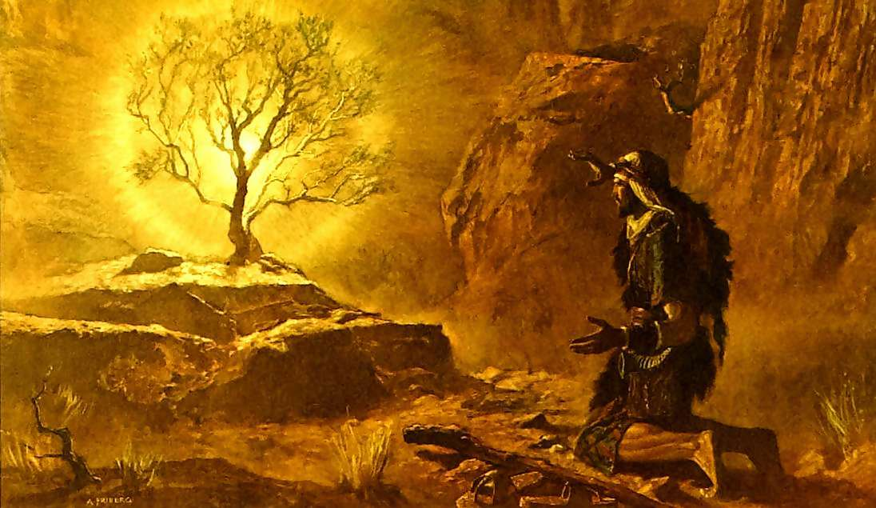
Exodus 3:14-15 NASB God said to Moses, "I AM WHO I AM"; and He said, "Thus you shall say to the sons of Israel, 'I AM has sent me to you.

Slide 22
Exodus 3:14-15 NASB (15) God, furthermore, said to Moses, "Thus you shall say to the sons of Israel, 'The LORD, the God of your fathers, the God of Abraham, the God of Isaac, and the God of Jacob, has sent me to you.' This is My name forever, and this is My memorial-name to all generations.
“THE LORD” – “Jehovah” or “Yahweh”
(“Self-Existent One” – “I AM”)

Slide 23
The 23 “I Am” Statements in the Gospel of John!
“I Am the Bread of Life” (John 6:35)
“I Am the Door” (John 10:9)
“I Am the Good Shepherd” (John 10:11)
“I Am the Resurrection & the Life” (John 11:25)
“I Am the Way, the Truth & the Life” (John 14:6)

Slide 24
John 8:24 NASB "Therefore I said to you that you will die in your sins; for unless you believe that I am He, you will die in your sins.“
(“He” is added by the translators)

Slide 25
John 8:58 NASB Jesus said to them, "Truly, truly, I say to you, before Abraham was born, I am."

Slide 26
John 18:4-6 NASB … "Whom do you seek?" (5) They answered Him, "Jesus the Nazarene." He said to them, "I am He." And Judas also, who was betraying Him, was standing with them. (6) So when He said to them, "I am He," they drew back and fell to the ground.

Slide 27
The Person of
Jesus Christ
The Deity of
Christ!
(Part 2)

Slide 28
Philippians 2:5-8 NASB Have this attitude in yourselves which was also in Christ Jesus, (6) who, although He existed in the form of God, did not regard equality with God a thing to be grasped, …

Slide 29
Philippians 2:5-8 NASB (Cont.) (7) but emptied Himself, taking the form of a bond-servant, and being made in the likeness of men. (8) Being found in appearance as a man, He humbled Himself by becoming obedient to the point of death, even death on a cross.

Slide 30
Joel 2:32 NIV And everyone who calls on the name of the LORD will be saved …

Slide 31
Romans 10:9 NIV If you declare with your mouth, "Jesus is Lord," and believe in your heart that God raised him from the dead, you will be saved.

Slide 32
Romans 10:13 NIV for, "Everyone who calls on the name of the Lord will be saved."

Slide 33
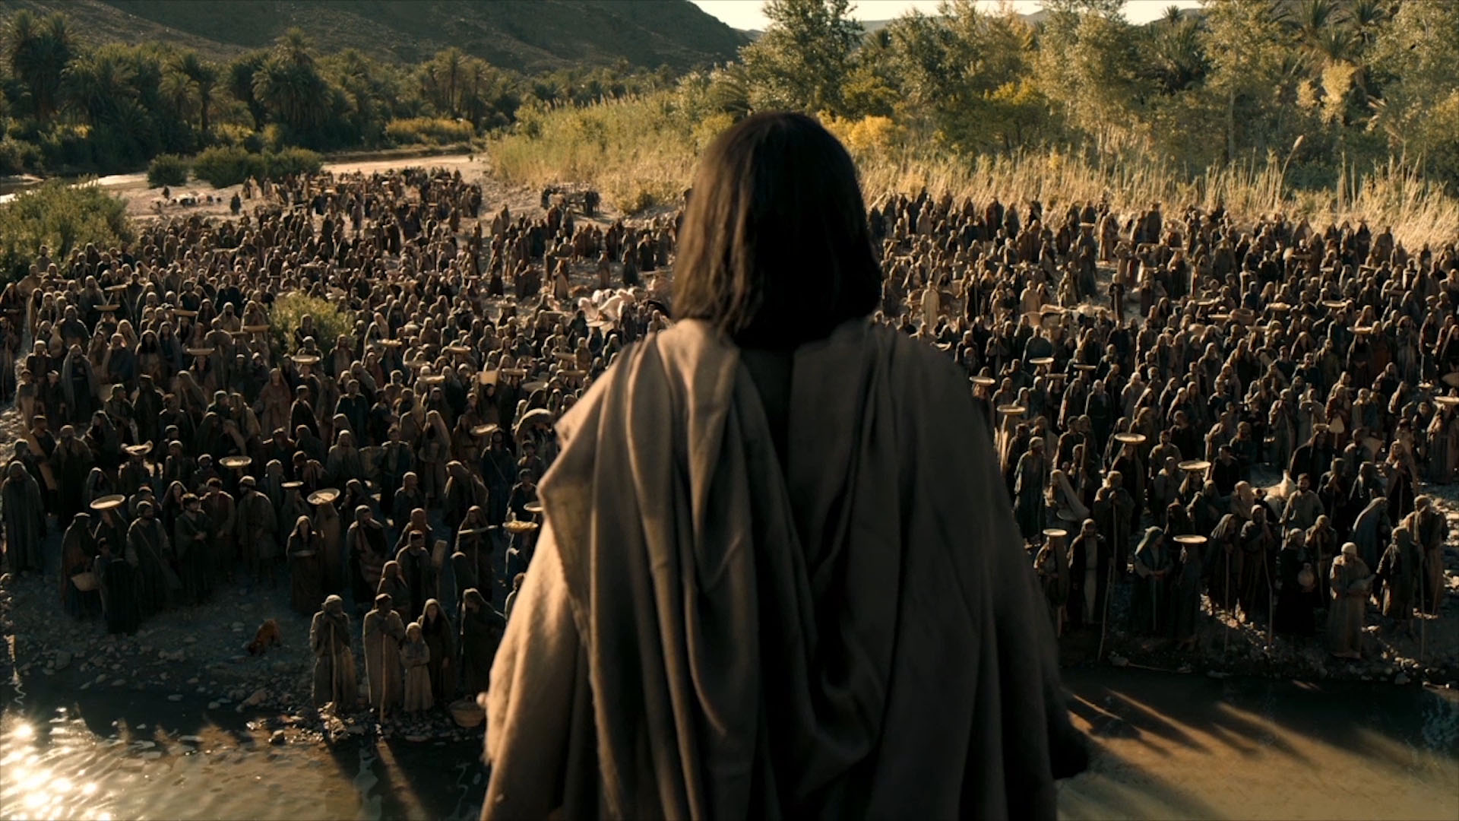
AT THE END OF THE SERMON ON THE MOUNT,
“THE CROWDS WERE ASTONISHED AT HIS TEACHING, FOR HE WAS
TEACHING THEM AS ONE WHO HAD AUTHORITY, AND
NOT AS THEIR SCRIBES” (Matthew 7:28-29)
“You have heard it said … but I say unto you …”

Slide 34
Matthew 5:18 NASB "For truly I say to you, until heaven and earth pass away, not the smallest letter or stroke shall pass from the Law until all is accomplished.
He Placed His Words On Equal Ground With
Old Testament Scripture

Slide 35
Matthew 24:35 NASB "Heaven and earth will pass away, but My words will not pass away.
He Placed His Words On Equal Ground With
Old Testament Scripture

Slide 36
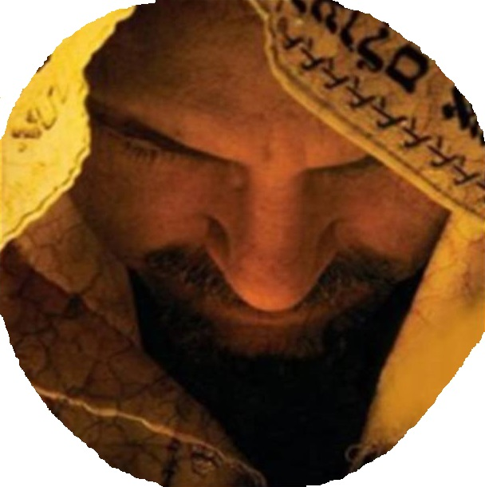
Jesus Christ
Our Great High Priest
(The Book
of Hebrews)

Slide 37
Jesus is Said to be Our Priest
or High Priest –
* 20 Times in the New Testament
* All 20 of Those Times Are in
the Book of Hebrews

Slide 38
Hebrews 1:1-3 NASB God, after He spoke long ago to the fathers in the prophets in many portions and in many ways, (2) in these last days has spoken to us in His Son, whom He appointed heir of all things, through whom also He made the world. …
.

Slide 39
Hebrews 1:1-3 NASB (Cont.) (3) And He is the radiance of His glory and the exact representation of His nature, and upholds all things by the word of His power. When He had made purification of sins, He sat down at the right hand of the Majesty on high,

Slide 40
Jesus is Seen in Hebrews as –
* Greater Than Angels
* Greater Than Moses
* Greater Than The O.T. Priests

Slide 41
“You are a Priest forever according
to the order of Melchizedek”
Genesis 14:18-20; Psalm 110:4
Hebrews 5:6; Hebrews 5:10
Hebrews 6:20; Hebrews 7:17

Slide 42
Hebrews 7:24-25 NASB but Jesus, on the other hand, because He continues forever, holds His priesthood permanently. (25) Therefore He is able also to save forever those who draw near to God through Him, since He always lives to make intercession for them.
“After the Order of Melchizedek”
Hebrews 5, 6 & 7

Slide 43
Hebrews 8:1 NASB Now the main point in what has been said is this: we have such a high priest, who has taken His seat at the right hand of the throne of the Majesty in the heavens,

Slide 44
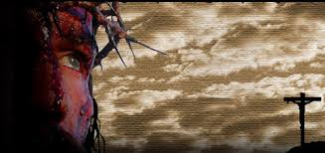

Slide 45
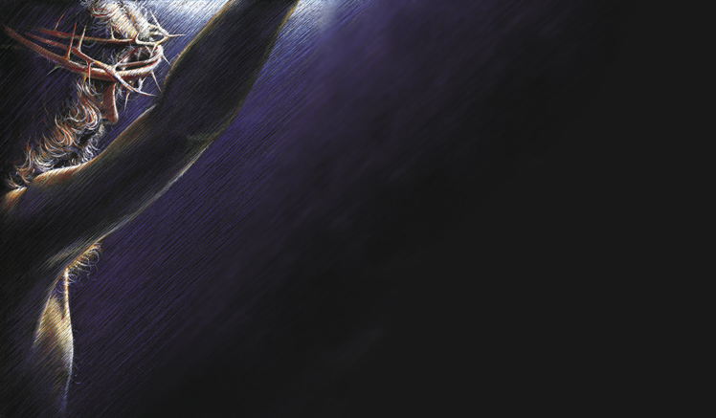

Slide 46
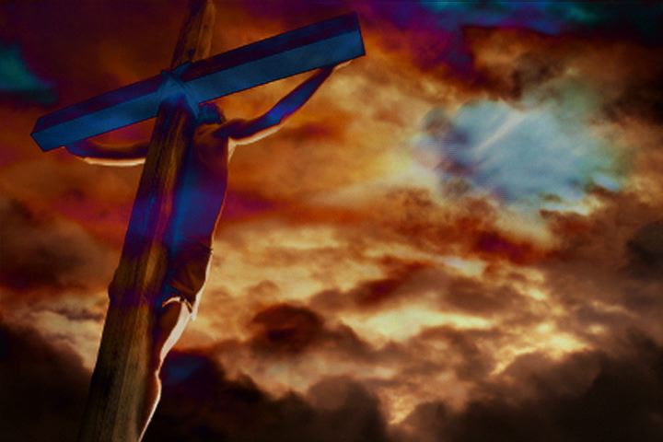
Acts 4:12 NASB "And there is salvation in no one else; for there is no other name under heaven that has been given among men by which we must be saved."

Slide 47
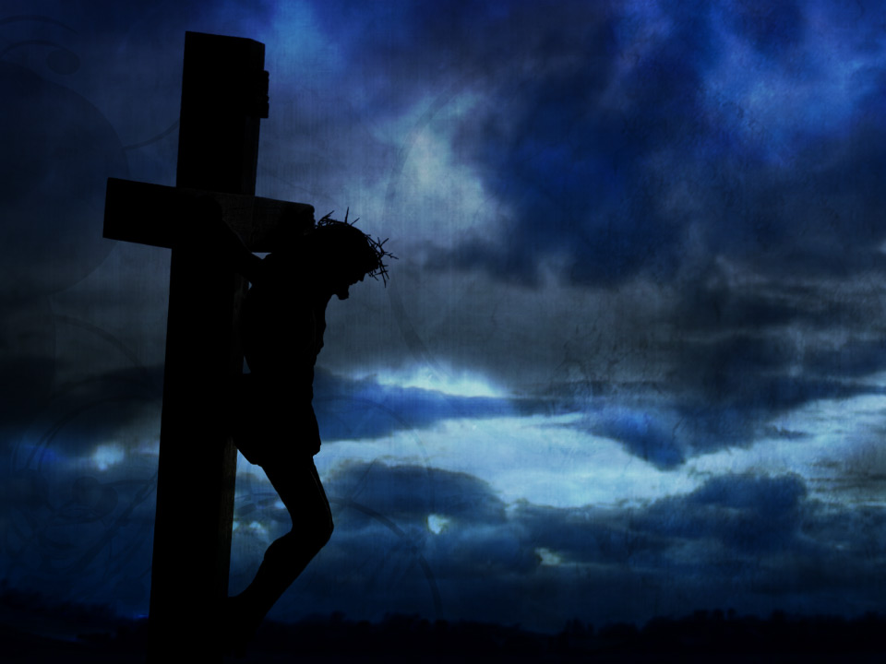

Slide 48
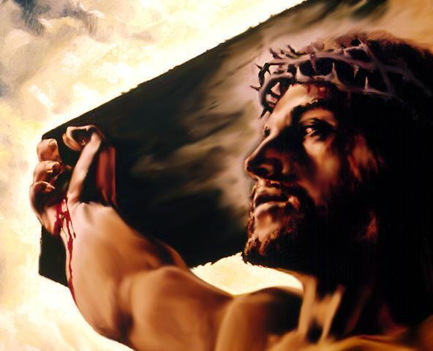
Life = Believing in Jesus Christ
Gospel of John – Emphasis on “Believing”
(“Believe” – found 55 Xs) (“Believes” – 14 Xs)
(“Believed” – 24 Xs) (“Believing” – 5 Xs)
A Total of 98 times the Gospel of John speaks
of the need to “believe” in who Jesus is!
Gospel of Matthew – Total use 11xs with only
1x referring to believing in Jesus
Gospel of Mark – Total use 15xs with only
2xs referring to believing in Jesus
Gospel of Luke – Total use 10xs with
none of these referring to believing in Jesus

Slide 49
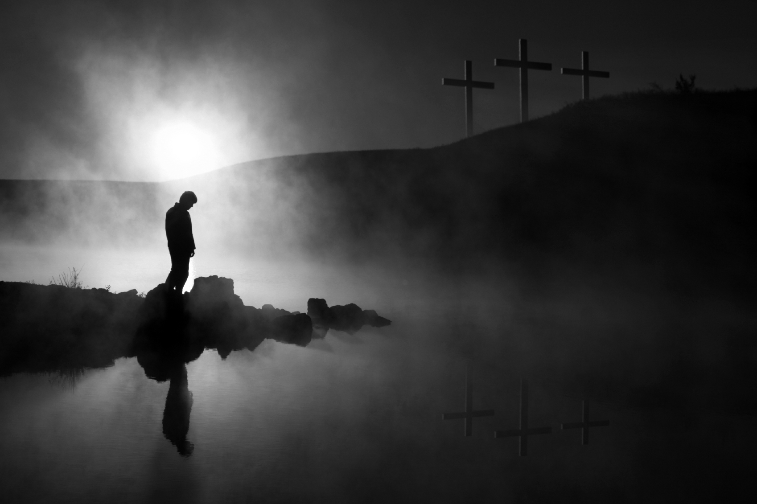
1a - Is There a God?
1b - Did He Create Me?
2 – Is the Bible
God’s Word?
3 – Is Jesus God, the Messiah & Savior?
If I have answered #1 & #2 then I can look to the Bible to answer #3

Slide 50
1 Peter 3:15 – “But sanctify
Christ as Lord in your hearts,
always being ready to make a defense
to everyone who asks you to give an
account for the hope that is in you,
yet with gentleness and reverence;”

Slide 52
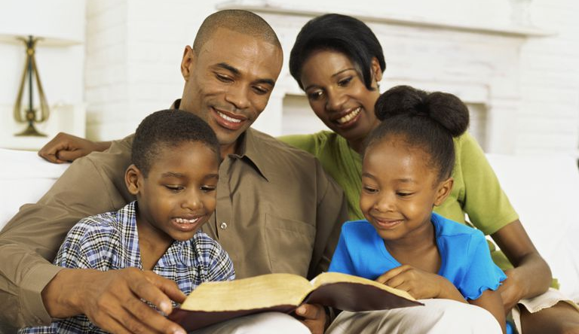
One Generation
to Another

Slide 53
With
Rick McGough
PART 8

Slide 54
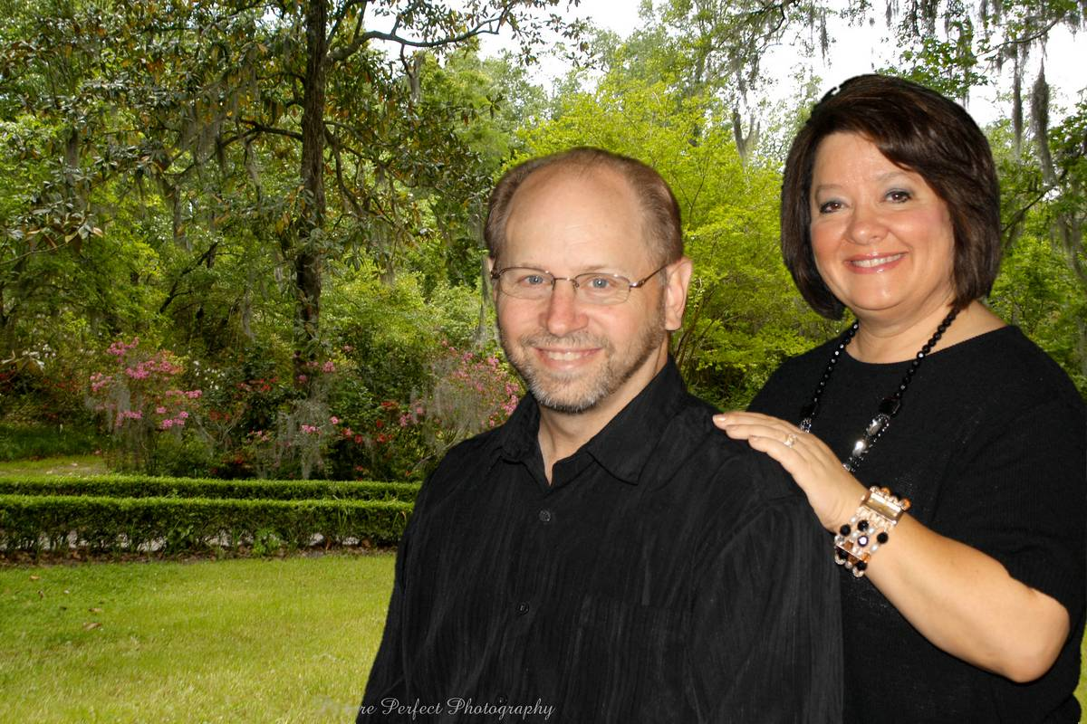
For More Information or to
Schedule a Speaking Engagement
Contact Rick at
rick@lcapologetics.org
or at 309-738-4863
or localchurchapologetics.org

