Slide 1
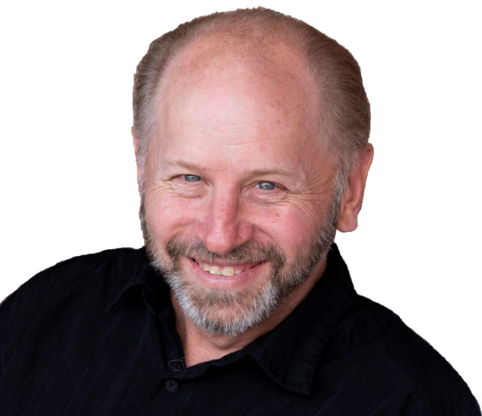
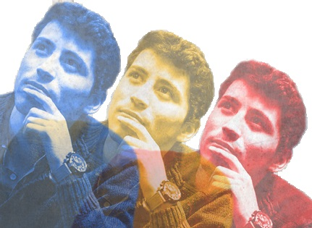
With
Rick McGough
PART 7

Slide 2
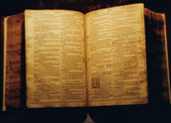
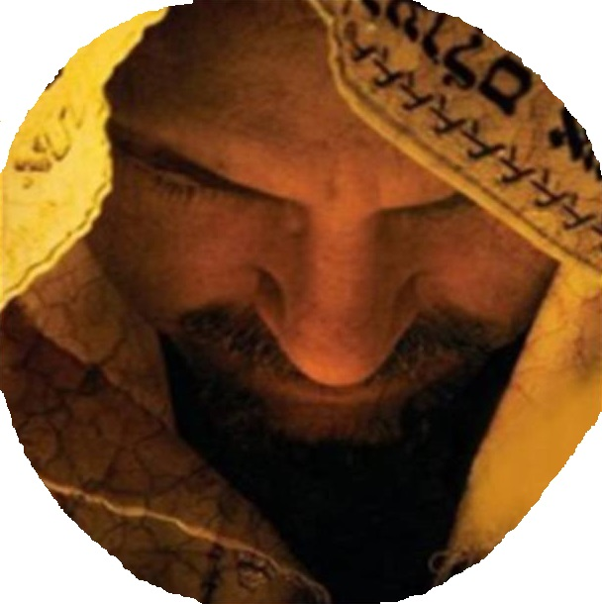
Faith & Reason Made Simple
(Part 7)
The Person of
Jesus Christ!

Slide 3
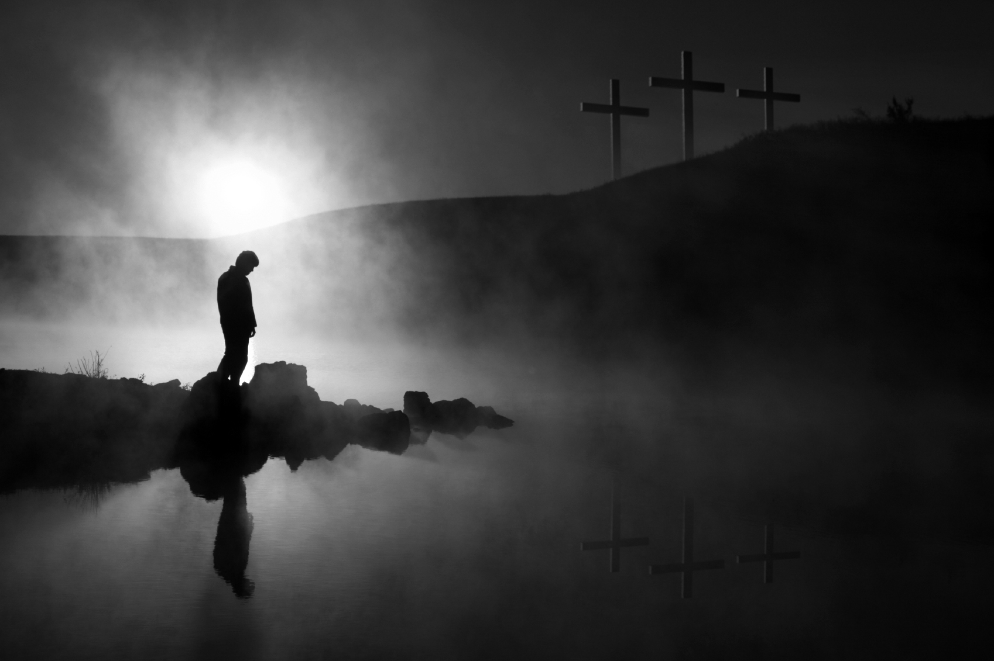
1a - Is There a God?
1b - Did He Create Me?
2 – Is the Bible
God’s Word?
3 – Is Jesus God, the Messiah & Savior?
If I have answered #1 & #2 then I can look to the Bible to answer #3

Slide 4
Challenge #1: Scholars Are Uncovering a Radically Different Jesus through Ancient Documents (Gnostic Gospels) Just as Credible as the Four Gospels
Challenge #2: The Bible’s Portrait of Jesus Can’t Be Trusted Because the Church Tampered with the Text
Challenge #3: New Explanations Have Disproved Jesus’ Resurrection
Challenge #4: Christianity’s Beliefs about Jesus Were Copied from Pagan Religions
Challenge #5: Jesus Was an Impostor Who Failed to Fulfill the Prophecies about the Messiah
Challenge #6: People Should Be Free to Pick and Choose What to Believe about Jesus

Slide 5
The Da Vinci Code (novel, 2003; movie, 2006): Jesus as a mortal prophet. This fictional mystery claims that Jesus and Mary Magdalene had children whose descendants are still living today.

Slide 6
The Da Vinci Code (novel, 2003; movie, 2006): Jesus as a mortal prophet. This fictional mystery claims that Jesus and Mary Magdalene had children whose descendants are still living today.
Over 80 Million Copies Sold Worldwide!

Slide 7
The Da Vinci Code (novel, 2003; movie, 2006): Jesus as a mortal prophet. This fictional mystery claims that Jesus and Mary Magdalene had children whose descendants are still living today.
The Movie (2006) Grossed over $758,000,000!

Slide 8
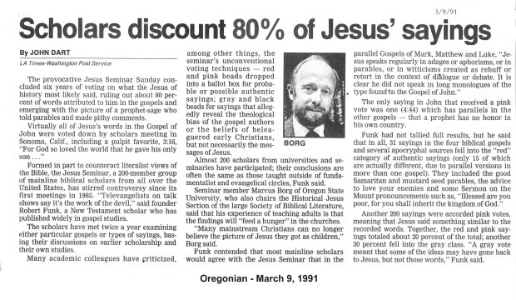
1985
Liberal “Scholars” Vote
to Determine if Jesus
really said what the Bible
says He said
Likewise, the seminar followed Modernist tradition by denying the miracles, divinity and resurrection of Jesus.

Slide 9
Jesus Christ
Was a
Historical
Person

Slide 10
Jesus Was a Historical Person
The Bible, God’s Word
Declares That Jesus Christ
Lived Here on this Earth
Approximately
2,000 Years Ago
(Along with Historical People,
Places & Events)
(E.G. - Note the Gospel of Luke)

Slide 11
Jesus Was a Historical Person
The Impact of Jesus Christ Upon the World
* Changed Lives & Nations
* Women’s Rights
* Justice & Mercy
* Calendar (2019 A.D. or C.E.)

Slide 12
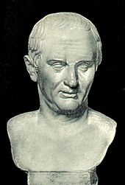
Jesus Did Live Here on Earth!
Tacitus (Roman Historian)
(While speaking of Nero’s response to the fire of Rome)
Consequently, to get rid of the report, Nero fastened the guilt and inflicted the most exquisite tortures on a class hated for their abominations, called Christians by the populace. Christus, from whom the name had its origin, suffered the extreme penalty during the reign of Tiberius at the hands of one of our procurators, Pontius Pilatus, and a most mischievous superstition, thus checked for the moment, again broke out not only in Judaea, the first source of the evil, but even in Rome,

Slide 13
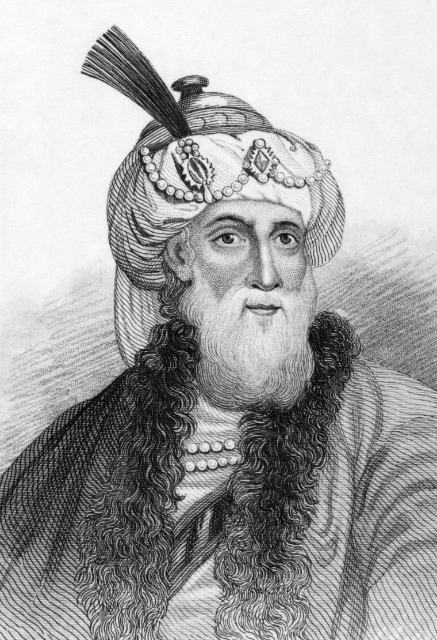
Jesus Did Live Here on Earth!
Josephus (Antiquities 20.9.1) - “But the younger Ananus who, as we said, received the high priesthood, was of a bold disposition and exceptionally daring; he followed the party of the Sadducees, who
are severe in judgment above all the Jews, as we have already shown. As therefore Ananus was of such a disposition, he thought he had now a good opportunity, as Festus was now dead, and Albinus was still on the road; so he assembled a council of judges, and brought before it the brother of Jesus the so-called Christ, whose name was James, together with some others, and having accused them as law-breakers, he delivered them over to be stoned.”

Slide 14
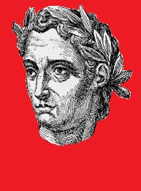
Jesus Did Live Here on Earth!
Pliny the Younger (a Lawyer, Author & Magistrate of 1st Century Rome) speaks of
Jesus & His followers
Pliny the Younger, in Letters 10:96, recorded early Christian worship practices including the fact that Christians worshiped Jesus as God and were very ethical, and he includes a reference to the love feast and Lord’s Supper

Slide 15
Jesus Did Live Here on Earth!
Writings of the Sanhedrin speak of Jesus’ crucifixion
The Babylonian Talmud (Sanhedrin 43a) confirms Jesus' crucifixion on the eve of Passover and the accusations against Him of practicing sorcery and encouraging Jewish apostasy.
"On the Eve of Passover, they hung Jesus of Nazareth for sorcery and enticing Israel [to idolatry]."

Slide 16
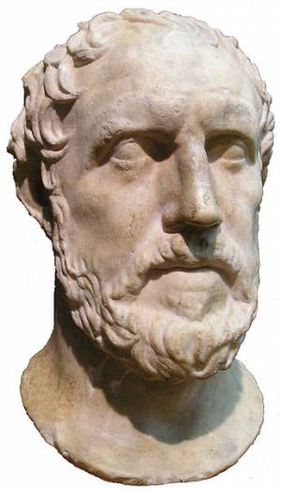
Jesus Did Live Here on Earth!
Lucian of Samosata was a second-century
Greek writer who speaks of Jesus
Lucian admits that Jesus was worshiped by Christians, introduced new teachings, and was crucified for them. He said that Jesus' teachings included the brotherhood of believers, the importance of conversion, and the importance of denying other gods. Christians lived according to Jesus’ laws, believed themselves to be immortal, and were characterized by contempt for death, voluntary self-devotion, and renunciation of material goods.

Slide 17
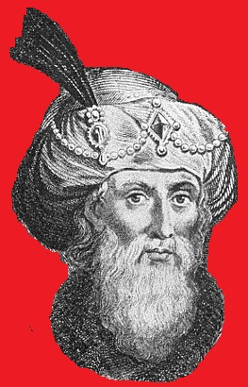
Jesus Did Live Here on Earth!
The fact that Jesus lived here on earth
is confirmed not only by the Bible, but by
numerous other historical documents, which also confirm important aspects of Jesus’ work of redemption.

Slide 18
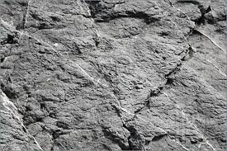
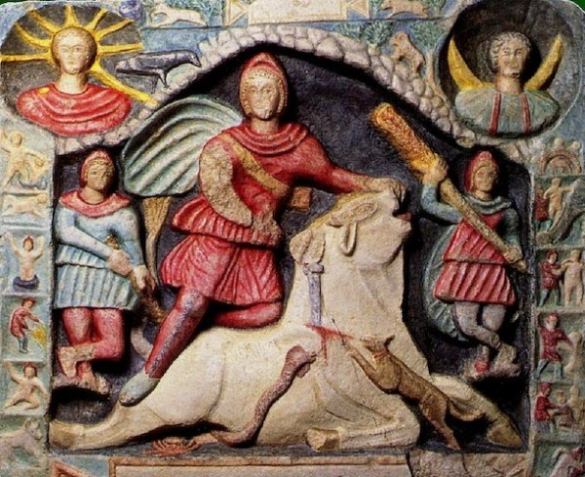
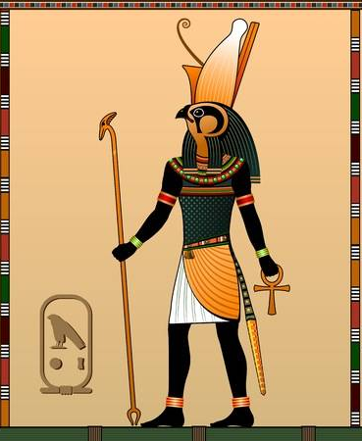
Is the Biblical Account of Jesus Merely a Retelling
of Ancient Deity Myths?
MITHRAS
(MITHRA)
BORN OF A VIRGIN?
HAD 12 DISCIPLES?
PERFORMED MIRACLES?
DEAD FOR 3 DAYS?
ROSE FROM THE DEAD?
“GOOD SHEPHERD”?
HORUS

Slide 19
Is the Biblical Account of Jesus Merely a Retelling
of Ancient Deity Myths?
MITHRAS (MITHRA)
coldcasechristianity.com
alwaysbeready.com
searchcreation.org
HORUS

Slide 20
The Bodily
Resurrection of
Jesus Christ
from the Dead

Slide 21
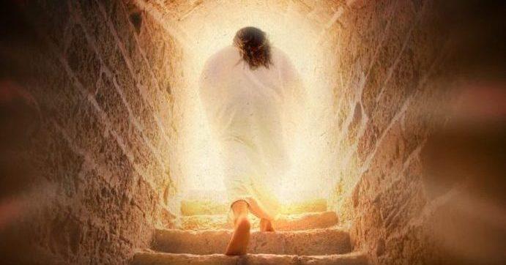
1 Corinthians 15:14 (NIV) “And if Christ has not been raised, our preaching is useless and so is your faith.”

Slide 22
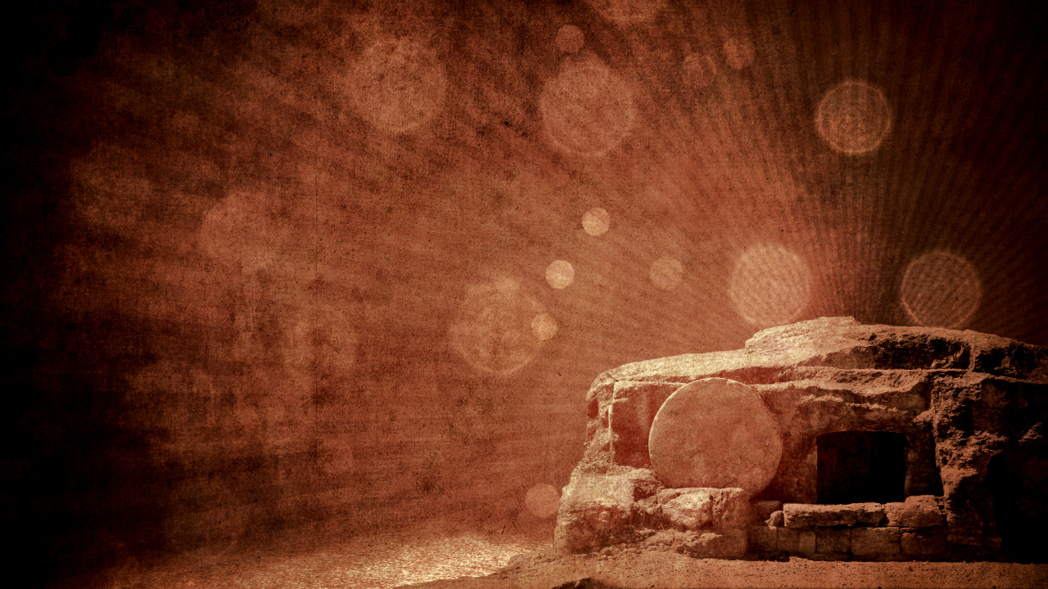
Dr. Gary Habermas (One of the world’s foremost experts on the resurrection of Jesus) says most contemporary critical scholars agree to these 9 facts!
1. The Disciples believed they had encounters with the risen Jesus!
2. The Disciples were transformed from
fearful doubters to bold proclaimers!
3. Jesus’ Tomb was empty!
4. The Resurrection message was central to early church teachings!
5. Jewish leaders could not disprove the disciples message!
6. The Resurrection was crucial to the church’s birth & rapid spread!
7. Sunday became the primary day of worship!
8. James, (brother of Jesus) was transformed from skeptic to believer!
9. Paul (Saul) was transformed by his believed encounter with Christ!

Slide 23
Eye Witnesses!
Hundreds Saw Jesus Alive
After His Resurrection!
They Were Still
Alive When This
Scripture Was
Written!

Slide 24
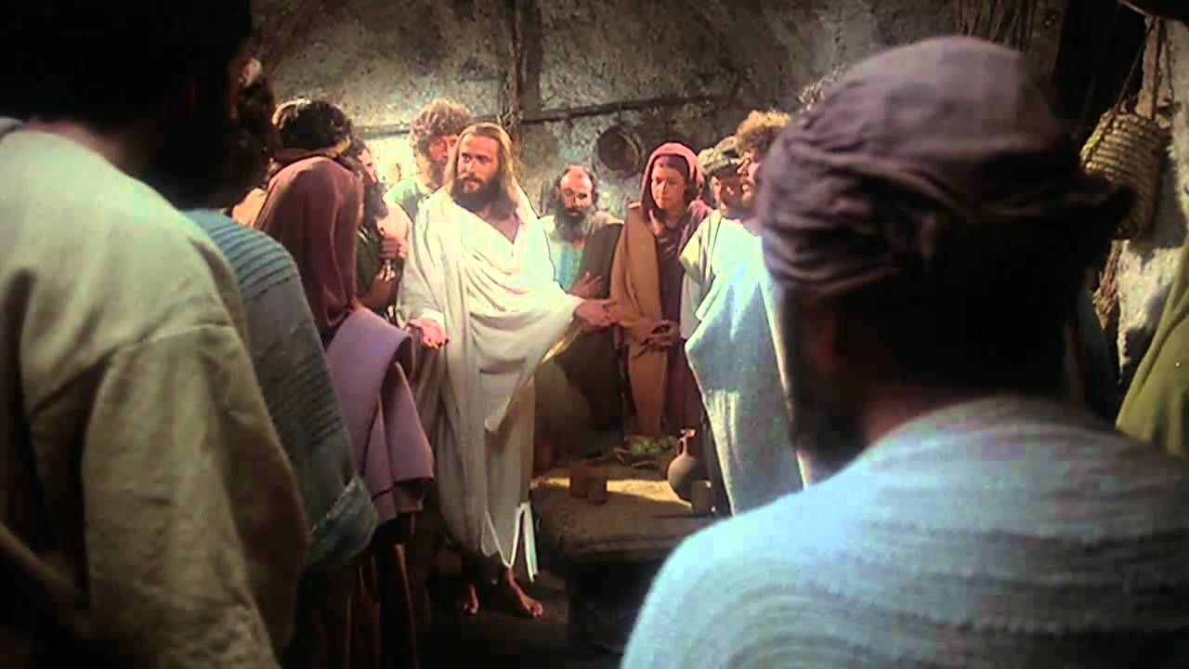

Slide 25
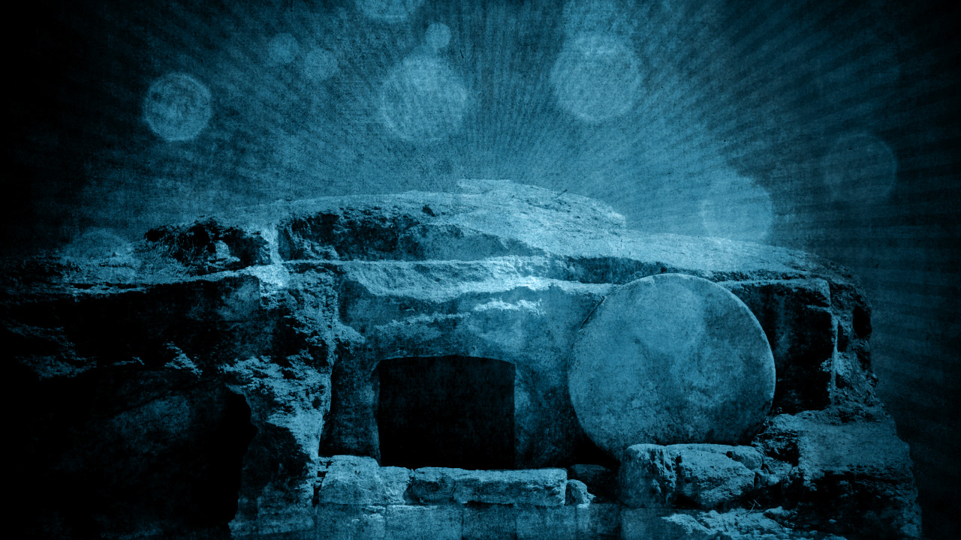
His Tomb
Was Empty!

Slide 26
Women Witnesses of
the Empty Tomb & Resurrection
(Matt. 28:1-10) (Mk. 16:1-11) (Lk. 24:1-11) (Jn. 20:1, 11-18)
(Patriarchal Society – Women were not even allowed to be a witness
in a court case)
(Biblical accounts of women as the
first witnesses shows that the
Bible’s account is not fictitious)

Slide 27
Mark 16:9 NASB [Now after He had risen early on the first day of the week, He first appeared to Mary Magdalene, from whom He had cast out seven demons.

Slide 28
The Disciples
Were
Transformed!

Slide 29
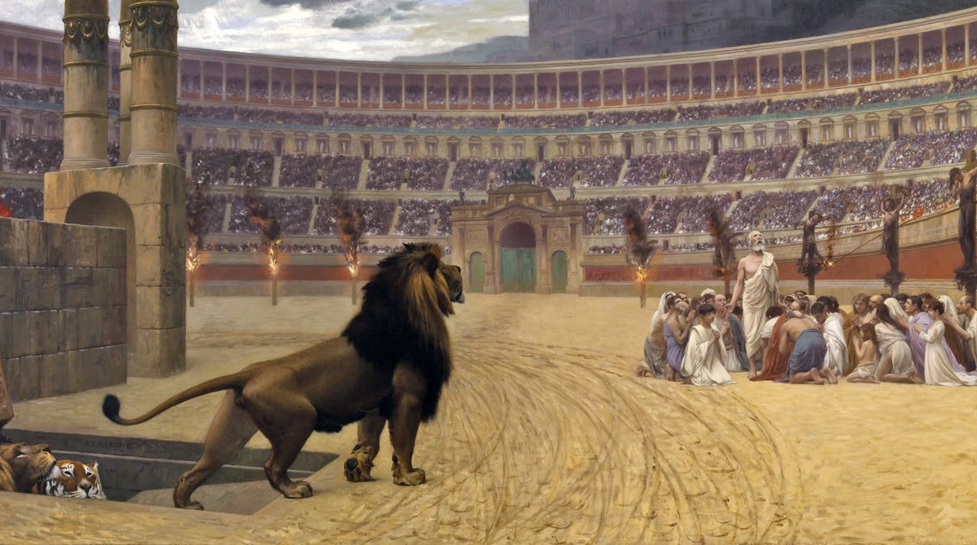
Early Christians
Martyred For Their Faith

Slide 30
Transformation of Millions
(or Billions)!
Millions (or Billions) of changed lives throughout the centuries give convincing evidence that Jesus Christ lived, died on the cross, and bodily rose from the grave just as the Bible says He did!

Slide 31
The Person of Jesus Christ
The Central
Character
of All of
Scripture!

Slide 32
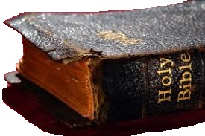
“Scripture” & “Scriptures”
52 times in the NASB
53 times in the KJV
Speaks of the
Old Testament

Slide 33
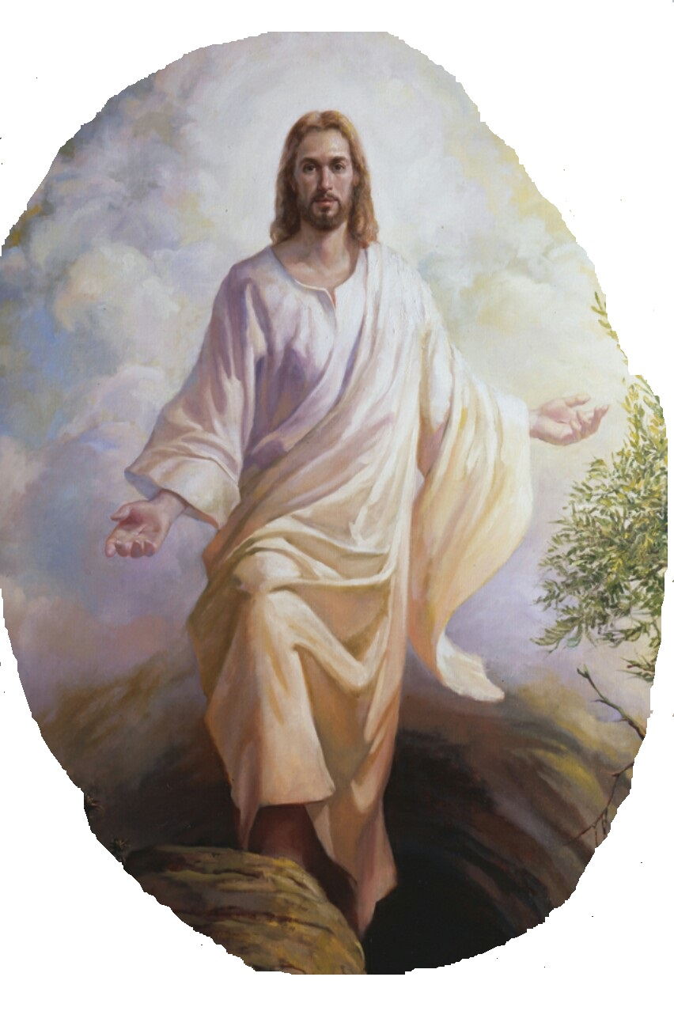
2 Timothy 3:15-16 KJV And that from a child thou (Timothy) hast known the holy scriptures (of the Old Testament), which are able to make thee wise unto salvation through faith which is in Christ Jesus.
(16) All scripture is given by inspiration of God, and is profitable for doctrine, for reproof, for correction, for instruction in righteousness:

Slide 34
John 5:39 NASB "You search the Scriptures because you think that in them you have eternal life; it is these that testify about Me;

Slide 35
Luke 24:27 NASB Then beginning with Moses and with all the prophets, He explained to them the things concerning Himself in all the Scriptures.

Slide 36
Acts 17:2-3 NASB And according to Paul's custom, he went to them, and for three Sabbaths reasoned with them from the Scriptures, (3) explaining and giving evidence that the Christ had to suffer and rise again from the dead, and saying, "This Jesus whom I am proclaiming to you is the Christ."

Slide 37
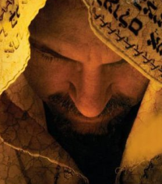
The Person of Jesus Christ
Jesus Christ is the Central Character of the Entire Bible
Old Testament Types & Shadows
* Passover Lamb
* Ark * Scapegoat
* Rahab’s Scarlet Cord
* Brazen Serpent
* Melchizedek * Sin & Guilt Offerings
* Moses/Joshua – Promise Land
* Manna & Water From the Rock (Strike, Speak)

Slide 38
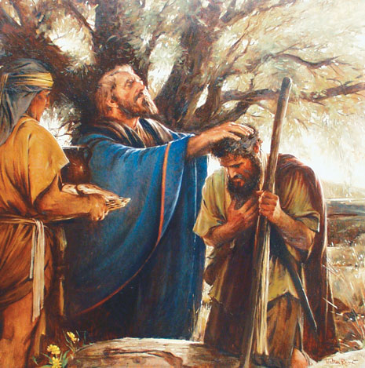
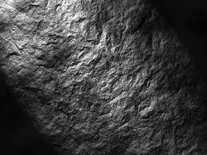
Melchizedek
Genesis 14:18-20
Psalm 110:4
The Book of Hebrews

Slide 39
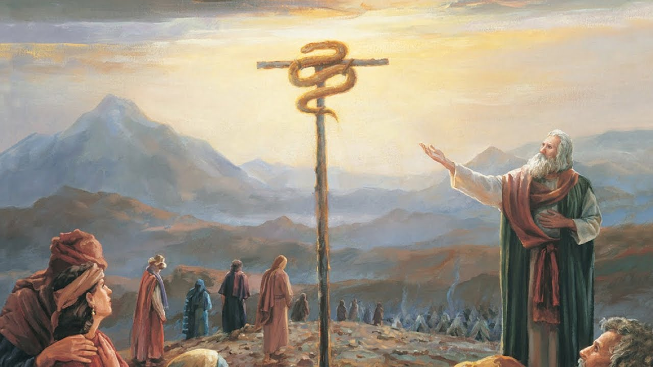
Numbers 21
(The Brazen Serpent)

Slide 40
John 3:14-15 NASB "As Moses lifted up the serpent in the wilderness, even so must the Son of Man be lifted up; (15) so that whoever believes will in Him have eternal life.
Numbers 21
(The Brazen Serpent)

Slide 41
Galatians 3:13 NASB Christ redeemed us from the curse of the Law, having become a curse for us--for it is written, "CURSED IS EVERYONE WHO HANGS ON A TREE"--
Numbers 21
(The Brazen Serpent)

Slide 42
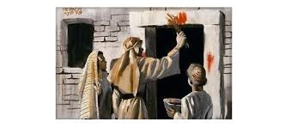
Exodus 12:13 NASB 'The blood shall be a sign for you on the houses where you live; and when I see the blood I will pass over you, and no plague will befall you to destroy you when I strike the land of Egypt.

Slide 43
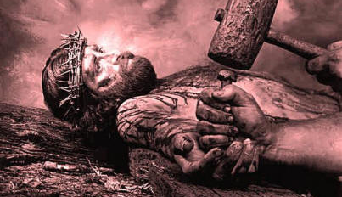
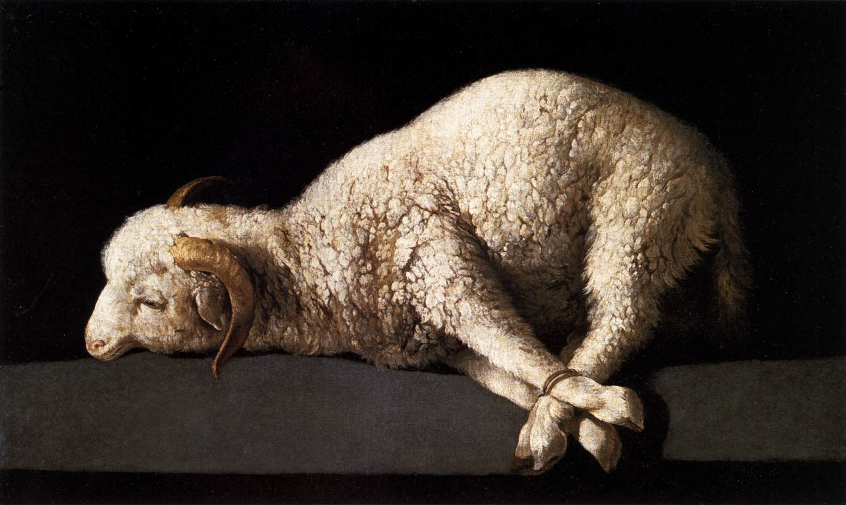
John 1:29 NASB The next day he saw Jesus coming to him and said, "Behold, the Lamb of God who takes away the sin of the world!

Slide 44
1 Corinthians 5:7 “…For Christ our Passover also has been sacrificed.”

Slide 45
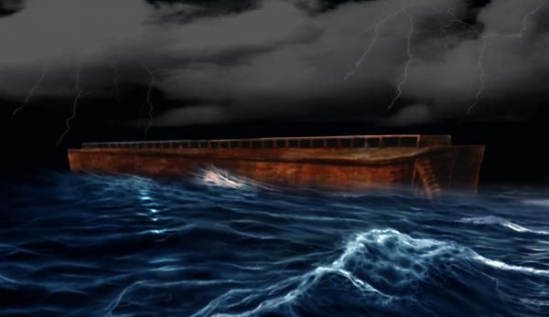

Slide 46
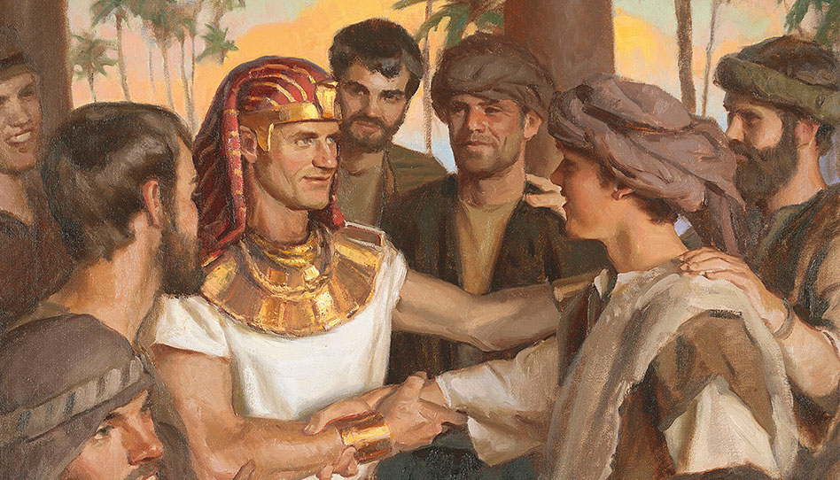
Joseph
(Type of Christ)

Slide 47
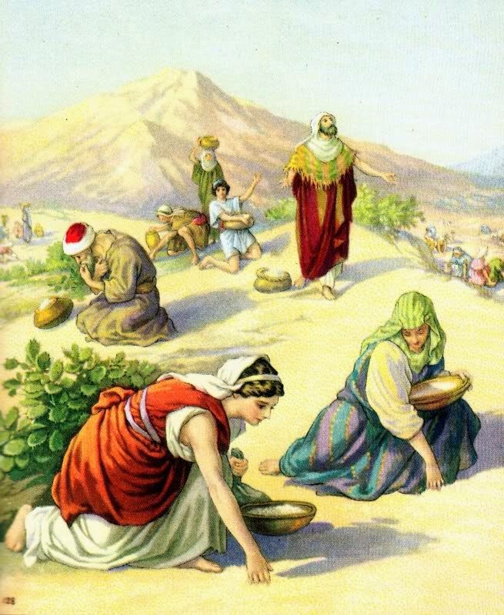

Slide 48
John 6:48-51 NASB "I am the bread of life. (49) "Your fathers ate the manna in the wilderness, and they died. (50) "This is the bread which comes down out of heaven, so that one may eat of it and not die. (51) "I am the living bread that came down out of heaven; if anyone eats of this bread, he will live forever; …"

Slide 49
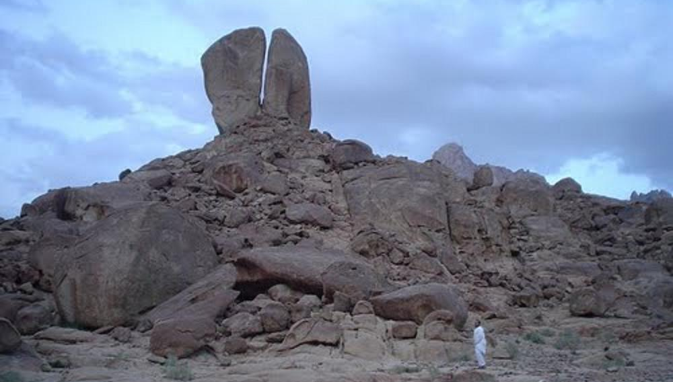
Rephidim
(In Modern Saudi Arabia)
Smite the Rock – Ex. 17:6
Speak to the Rock – Num. 20:8
“Water From the Rock”

Slide 50
The Person of Jesus Christ
The Central
Character
of All of
Scripture!

Slide 51
The Person of Jesus Christ
* Historical Person
* Not a Copy of
Mythical Deities
* Rose From the Dead
* Central Character
of All Scripture

Slide 52
With
Rick McGough
PART 7

