Slide 1

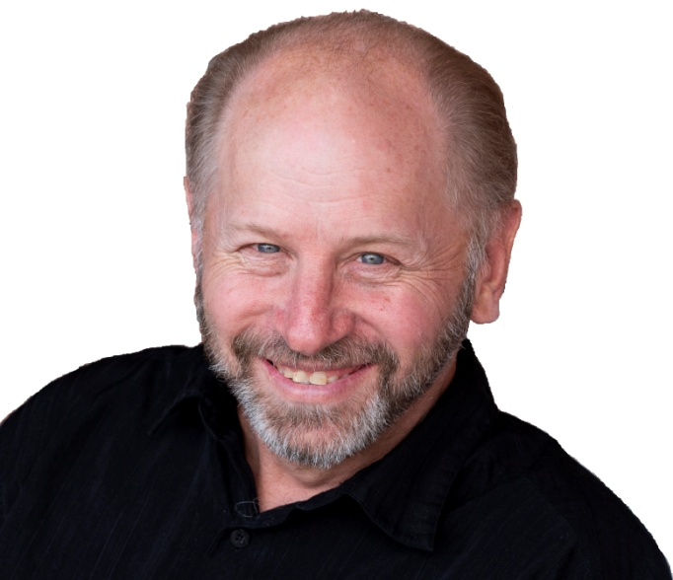




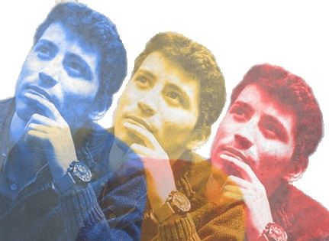

With
Rick McGough
PART 5

Slide 2

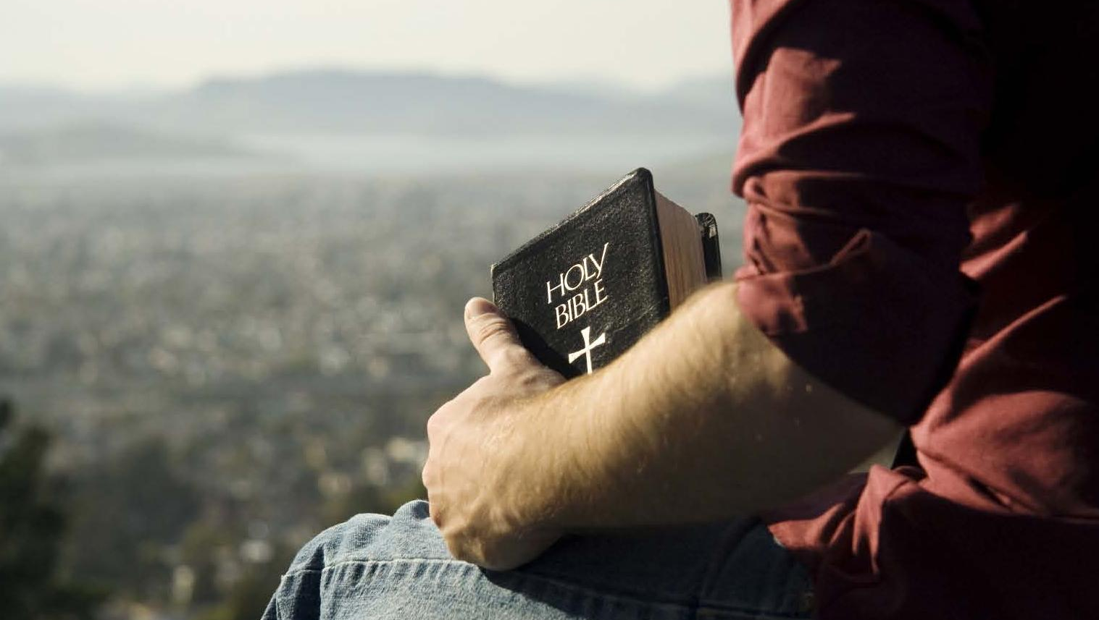
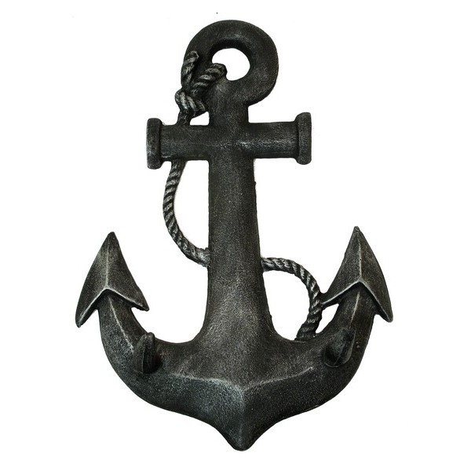
Faith & Reason
Made Simple
(Part 5)
The Anchor
of our Faith

Slide 3
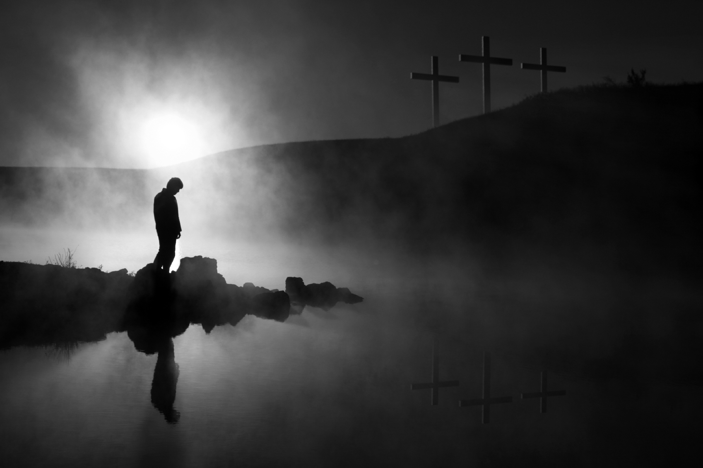
1a - Is There a God?
1b - Did He Create Me?
2 – Is the Bible
God’s Word?

Slide 4
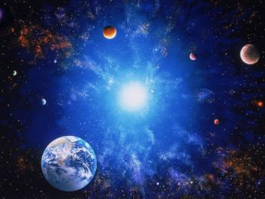

Romans 1:20 NASB For since the creation of the world His invisible attributes, His eternal power and divine nature, have been clearly seen, being understood through what has been made, so that they are without excuse.

Slide 5
Romans 1:20 NASB For since the creation of the world His invisible attributes, His eternal power and divine nature, have been clearly seen, being understood through what has been made, so that they are without excuse.
1
2
3

Slide 6
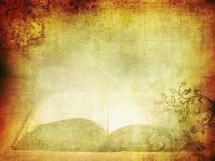
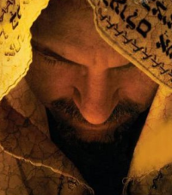
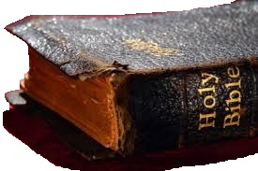
* General Revelation (Created Things)
* Special Revelation (The Bible) (Jesus Christ)

Slide 7
“All Scripture is inspired by God …”
2 Timothy 3:16

Slide 8
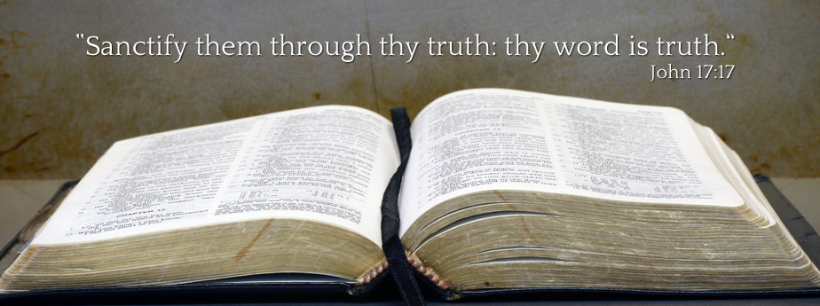

Slide 9
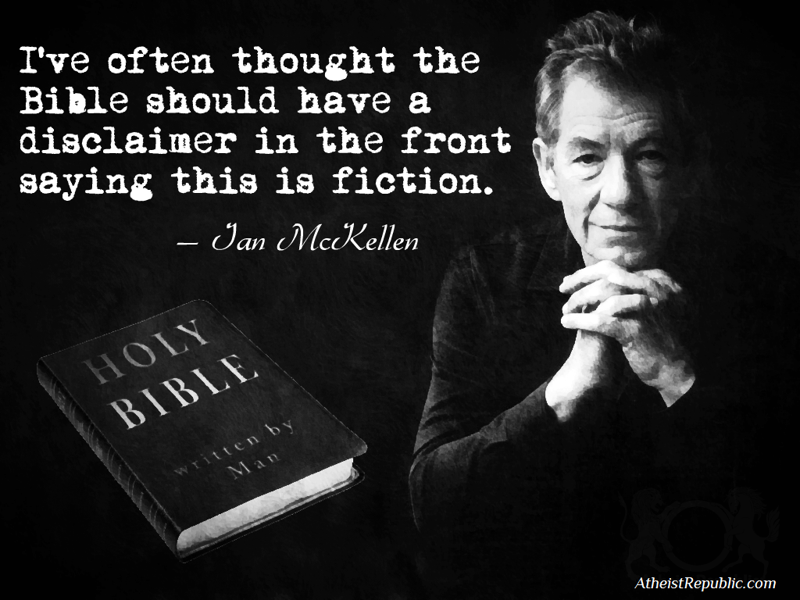

Slide 10
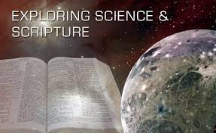
According to a 2006 study by sociologists Neil Gross (Harvard University) and Solon Simmons (George Mason University)
Only 6 percent of college professors said the Bible is ―the actual word of God while 51 percent described it as ―an ancient book of fables, legends, history and moral precepts.

Slide 11
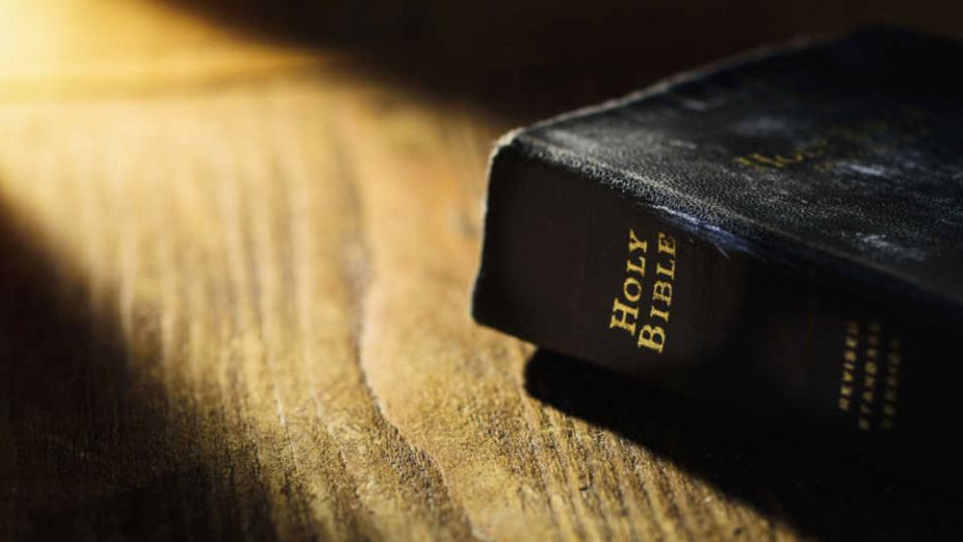
Why do
you believe
the Bible is the
Word of God?

Slide 12
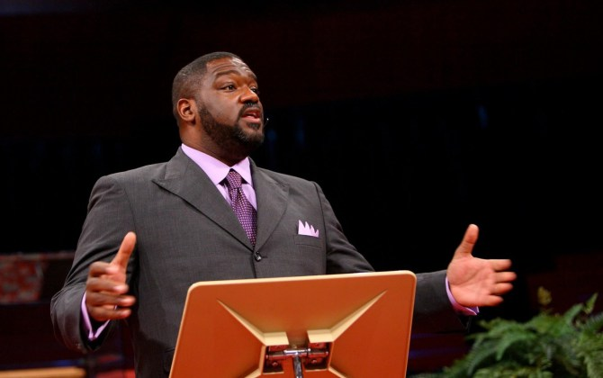
I choose to believe the Bible because it is a reliable collection of historical documents written down by eye witnesses during the lifetime of other eye witnesses. They report to us supernatural events that took place in fulfillment of specific prophecies and claim to be divine rather than human in origin.
Dr. Voddie Baucham

Slide 13
I choose to believe the Bible because it is a reliable collection of historical documents written down by eye witnesses during the lifetime of other eye witnesses. They report to us supernatural events that took place in fulfillment of specific prophecies and claim to be divine rather than human in origin.
These events are confirmed by,
and give us understanding of,
historical events and the
realities of the
world today.
Dr. Voddie Baucham

Slide 14


1 – Internal Unity
2 – Bibliographical Evidence
3 – Archaeology & History
4 – Medical Facts
5 – Scientific Facts
6 – Fulfilled Prophecy
a – Ancient Cities b – World Empires
c – Messianic
d – Jews Return to Israel
e – End Times/Jerusalem
7 – Changed Lives
8 – Indestructibility & Distribution

Slide 15
(1) Internal
Unity

Slide 16
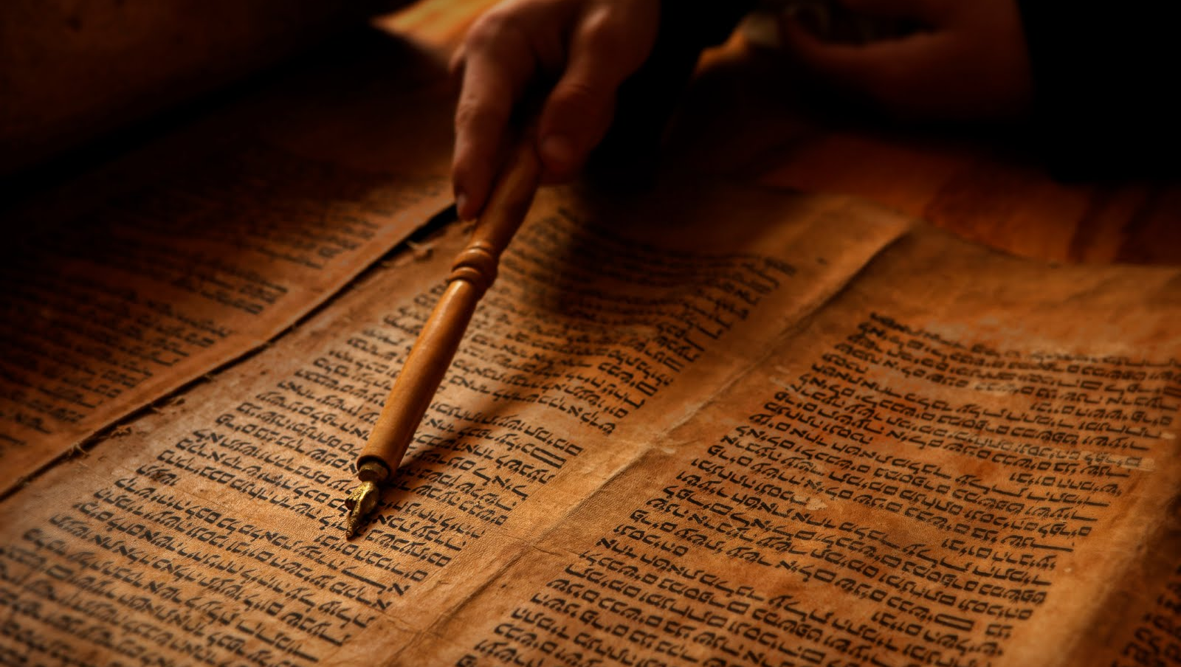
Simple Outline of the Bible’s Message
1 – God Created Mankind to Be His Sons & Daughters
(Genesis 1 & 2)

Slide 17
Simple Outline of the Bible’s Message
1 – God Created Mankind to Be His Sons & Daughters
(Genesis 1 & 2)
2 – Mankind Sinned & Was Separated From God (Death)
(Genesis 3)

Slide 18
Simple Outline of the Bible’s Message
1 – God Created Mankind to Be His Sons & Daughters
(Genesis 1 & 2)
2 – Mankind Sinned & Was Separated From God (Death)
(Genesis 3)
3 – God Fulfilled His Plan to Redeem Mankind in Christ
(Genesis 3 – Revelation 20)

Slide 19
Simple Outline of the Bible’s Message
1 – God Created Mankind to Be His Sons & Daughters
(Genesis 1 & 2)
2 – Mankind Sinned & Was Separated From God (Death)
(Genesis 3)
3 – God Fulfilled His Plan to Redeem Mankind in Christ
(Genesis 3 – Revelation 20)
4 – All God Planned in Creation Is Eternally Restored in Christ
(Revelation 21 – 22)

Slide 20
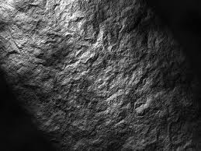

Claims of Inspiration!
The Bible Claims to Be the Word of God Throughout -
Or its Equivalent - Over 2,600 Times

Slide 21
Internal Unity!
40 Authors
- 66 Books
1,500+ Year Period
3 Continents & 3 Languages
400 Year Gap – O.T. to N.T.
Shepherds, kings, scholars, fishermen, prophets, a military general, a cupbearer, and a priest all penned portions of Scripture.

Slide 22
Internal Unity!
40 Authors
- 66 Books
An Unfolding Story
of Redemption from
Genesis through
Revelation

Slide 23
Internal Unity!
O.T. Linked to N.T.
40 Authors
- 66 Books
(Examples)
* O.T. - The Law
* N.T. – None Saved
by the Law,
* The Law is a Tutor
Leading to Christ

Slide 24
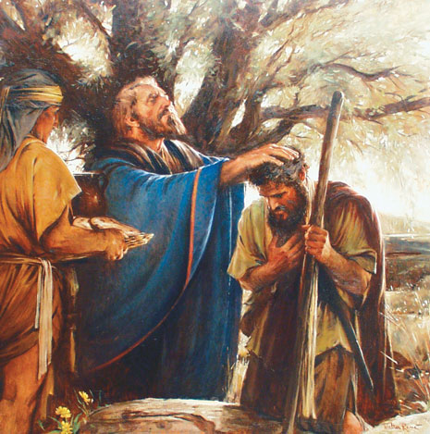
Internal Unity!
40 Authors
- 66 Books
O.T. Linked to N.T.
(Examples)
Melchizedek

Slide 25
Internal Unity!
Melchizedek
Genesis 14:18-20 NASB And Melchizedek king of Salem brought out bread and wine; now he was a priest of God Most High. (19) He blessed him and said, "Blessed be Abram of God Most High, Possessor of heaven and earth; (20) And blessed be God Most High, Who has delivered your enemies into your hand." He gave him a tenth of all.

Slide 26
Internal Unity!
Melchizedek
Psalms 110:4 NASB The LORD has sworn and will not change His mind, "You are a priest forever According to the order of Melchizedek."

Slide 27
Internal Unity!
Melchizedek
Hebrews 5:6 NASB just as He says also in another passage, "YOU ARE A PRIEST FOREVER ACCORDING TO THE ORDER OF MELCHIZEDEK."

Slide 28
Internal Unity!
Melchizedek
Hebrews 5:10 NASB being designated by God as a high priest according to the order of Melchizedek.

Slide 29
Internal Unity!
Melchizedek
Hebrews 6:20 NASB where Jesus has entered as a forerunner for us, having become a high priest forever according to the order of Melchizedek.

Slide 30
Internal Unity!
Melchizedek
Hebrews 7:17 NASB For it is attested of Him, "YOU ARE A PRIEST FOREVER ACCORDING TO THE ORDER OF MELCHIZEDEK."

Slide 31
Internal Unity!
Melchizedek
Hebrews 7:24-25 NASB but Jesus, on the other hand, because He continues forever, holds His priesthood permanently. (25) Therefore He is able also to save forever those who draw near to God through Him, since He always lives to make intercession for them.

Slide 32
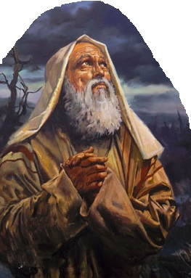
Internal Unity!
40 Authors
- 66 Books
O.T. Linked to N.T.
(Examples)
Abraham - Faith

Slide 33
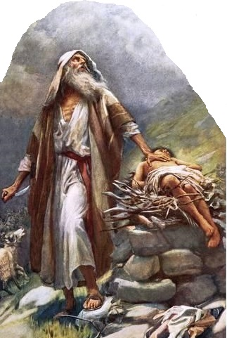
Internal Unity!
40 Authors
- 66 Books
O.T. Linked to N.T.
(Examples)
Abraham - Isaac

Slide 34
Internal Unity!
40 Authors
- 66 Books
Malachi (3:1-2) & (4:5-6)
(The Old Testament ends with prophetic
words about the coming of John the Baptist
who would precede the Messiah

Slide 35
Internal Unity!
40 Authors
- 66 Books
Matthew 3 – Mark 1 – Luke 1 & 3 – John 1
(The New Testament begins with the introduction of
John the Baptist and his ministry, preparing the way

Slide 36

Claims of Sincerity & Inspiration!
Luke 1:1-4 NASB Inasmuch as many have undertaken to compile an account of the things accomplished among us, (2) just as they were handed down to us by those who from the beginning were eyewitnesses and servants of the word, (3) it seemed fitting for me as well, having investigated everything carefully from the beginning, to write it out for you in consecutive order, most excellent Theophilus; (4) so that you may know the exact truth about the things you have been taught.

Slide 37
Claims of Sincerity & Inspiration!
1 Thessalonians 2:3-5 NIV (3) For the appeal we make does not spring from error or impure motives, nor are we trying to trick you. (4) On the contrary, we speak as those approved by God to be entrusted with the gospel. We are not trying to please people but God, who tests our hearts. (5) You know we never used flattery, nor did we put on a mask to cover up greed--God is our witness.

Slide 38
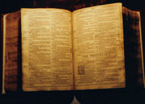
Internal Unity of the Bible
Jesus Christ is the Central Character of the Entire Bible
Old Testament Types & Shadows
* Passover Lamb
* Ark * Scapegoat
* Rahab’s Scarlet Cord
* Brazen Serpent
* Melchizedek * Sin & Guilt Offerings
* Moses/Joshua – Promise Land
* Manna & Water From the Rock (Strike, Speak)

Slide 39
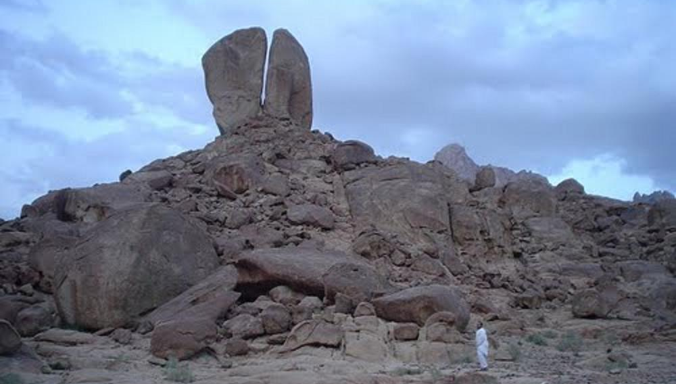
Rephidim
(In Modern Saudi Arabia)
Smite the Rock – Ex. 17:6
Water From
The Rock

Slide 40
Rephidim
(In Modern Saudi Arabia)
Smite the Rock – Ex. 17:6
Speak to the Rock – Num. 20:8
Water From
The Rock

Slide 41
Rephidim
(In Modern Saudi Arabia)
1 Corinthians 10:4 NASB (4) and all drank the same spiritual drink, for they were drinking from a spiritual rock which followed them; and the rock was Christ.
Water From
The Rock

Slide 42
Internal Unity of the Bible
Jesus Christ is the Central Character of the Entire Bible
Over 300 O.T. Prophecies
Fulfilled by Jesus Christ
(We will look at this in more detail in a latter
portion of the lesson & in the next lesson)

Slide 43
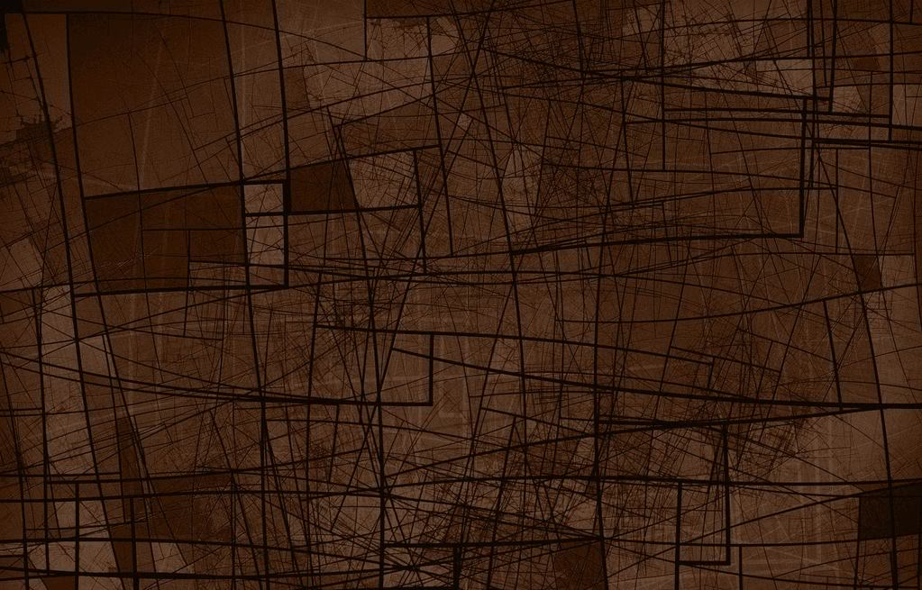

Embarrassing
Testimony
Adam & Eve (Sin)
Cain & Abel (Murder)
Noah (Drunk)
Abraham (Lying)
Jacob (Deception)
Joseph’s Brothers
Judah (Prostitution)
Moses (Angry)
Israel (Rebellion)
Samson (Lust)
Eli’s & Samuel’s Sons
David (Adultery/Murder)
Jesus’ Genealogy
Birth of Jesus (Humble)
Disciples (Greatest?)
Disciples (Afraid at Sea)
Peter (Rebuked 2x)
Peter (Denied Jesus)
Disciples (Sleeping)
Disciples (Fleeing)
Crucifixion
Women Witnesses

Slide 44
(2)
Bibliographical
Evidence

Slide 45
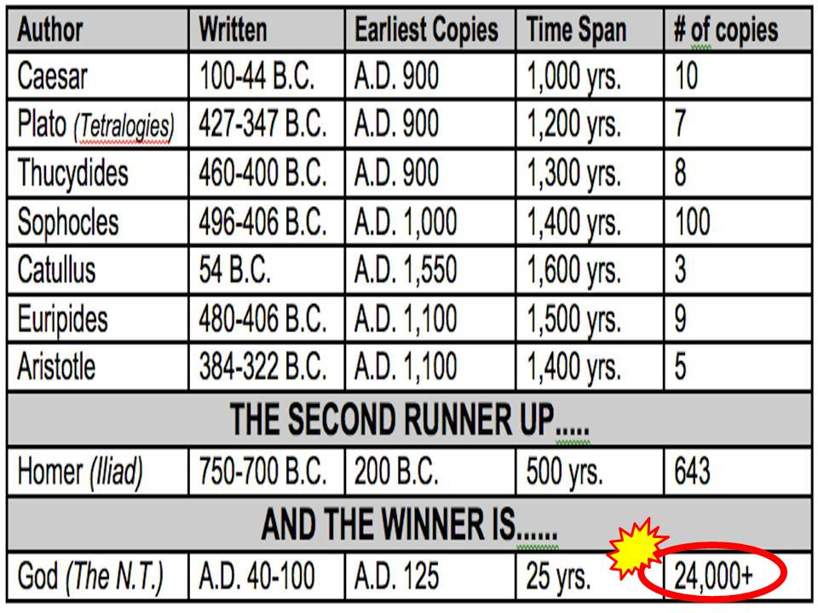

Slide 46

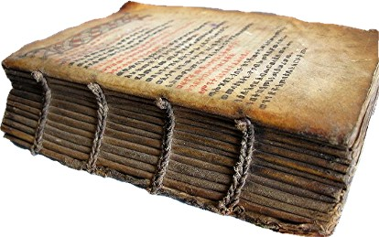
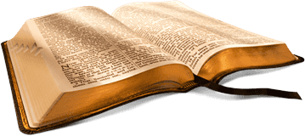
British Paleographer & Biblical & Classical Scholar
Sir Fredrick Kenyon
“The interval between the dates of the original composition and the earliest extant evidence becomes so small as to be in fact negligible, and the last foundation of any doubt that the Scriptures have come down substantially as they were written has now been removed. Both the authenticity and the general integrity of the books of the New Testament may be regarded as finally established.”

Slide 47

Citations of the New Testament by the Early Church Fathers
The Early Church Fathers
Clement of Rome
Origen of Alexandria
Tertullian, Irenaeus
Ignatius, Polycarp, Etc.
Cited, or Quoted the New Testament over 1 million times in their writings. Scholars have noted that if all of the manuscripts and New Testament evidence was destroys except for the writings of the early church fathers, practically the entire New Testament could be reconstructed by their writings alone.

Slide 48
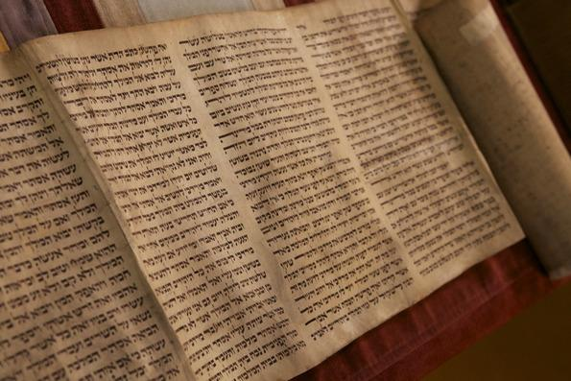
Scribes (Torah & Old Testament)
Scrolls

Slide 49
Scribes (Torah & Old Testament)
Scrolls
Josh McDowell
Torah Scroll (1450 A.D.

Slide 50
Scribes (Torah & Old Testament)
Scrolls
4,000 Scribal Rules!
Josh McDowell
Torah Scroll (1450 A.D.

Slide 51
Scribes (Torah & Old Testament)
Scrolls
4,000 Scribal Rules!
Josh McDowell
Torah Scroll (1450 A.D.
Extremely Meticulous!
Very Careful & Precise!

Slide 52
Scribes (Torah & Old Testament)
Scrolls
4,000 Scribal Rules!
Josh McDowell
Torah Scroll (1450 A.D.
Extremely Meticulous!
Very Careful & Precise!
Numbered Words & Letters!
Mistakes Often Meant Starting Over!

Slide 53
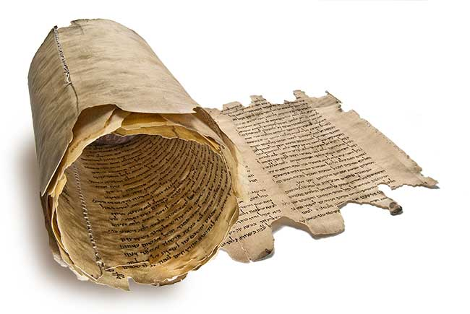
The
DEAD SEA
Scrolls
* The Dead Sea Scrolls date from 200BC to 68AD
* The Scrolls are made up of some 40,000 fragments
* Of these fragments, more than 500 books have
been reconstructed!
* This drastically reduces the time span from the
writing of the Old Testament books to our earliest
copies of them (About 1,000 years)
* The Dead Sea scrolls have also repeatedly
confirmed that the Old Testament Scriptures we
had before discovering them were extremely
accurate! 99.5% accurate!

Slide 54
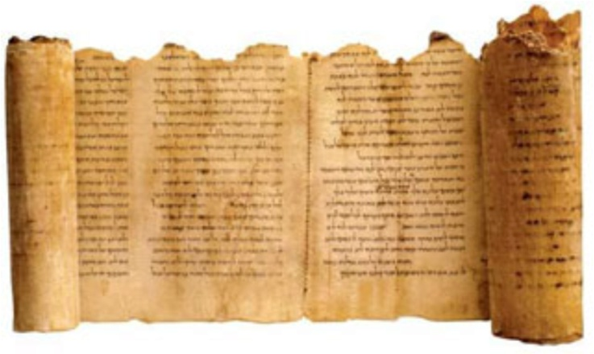
Approximately 1,000 Years
DEAD SEA
Oldest Copies Before
Dead Sea Scrolls
Scrolls
Example -
* Of the 166 words in Isaiah 53, there are only 17 letters in question. Ten of these letters are simply a matter of spelling. Four more letters are minor stylistic changes. The remaining letters comprise the word “light” which is added in verse 11, and does not affect the meaning.
* In other words, in one chapter of 166 words, there is only one word (3 letters) in question after a thousand years of transmission!

Slide 55
(3)
Archaeology
& History

Slide 56
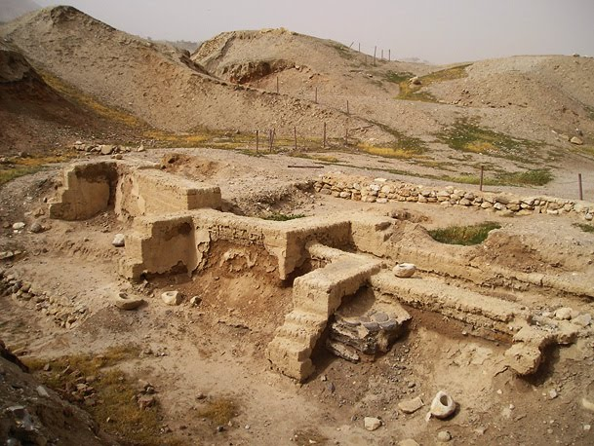
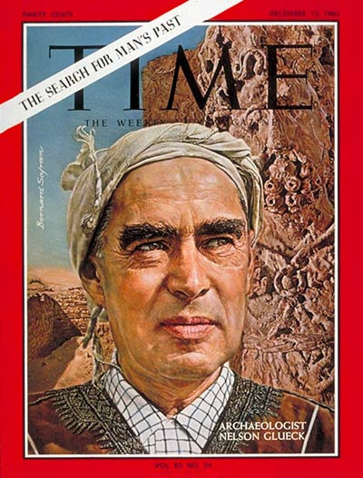
The Bible – God’s Word
Archaeology –
Confirming the Bible
(e.g. – Jericho)
“As a matter of fact, however, it may be stated categorically that no archaeological discovery has ever controverted a Biblical reference.” (Nelson Glueck) (Glueck, Nelson, Rivers in the Desert, New York: Grove Press, 1959, pp. 31-32.)

Slide 57
The Bible – God’s Word
James Mann (U.S. News & World Report)
“A wave of archaeological discoveries is altering
old ideas about the roots of Christianity and
Judaism – and affirming the Bible is more
historically accurate than many scholars thought.”
(U.S. News & World Report – August 24, 2981)

Slide 58
The Bible – God’s Word
32 Countries
54 Cities
9 Islands
Numerous Ports
Names & Titles of Priests
& Political Leaders
Deities That Certain Cities Worshipped
Weather Patterns
Particular Shipping Lanes
Laws & Customs
luke’s writings

Slide 59
The Bible – God’s Word
More than 80 details in the Book
of Acts alone have been
confirmed by historical
& archaeological research!

Slide 60
(4) Medical
Facts

Slide 61

The Bible – God’s Word
Modern Medicine confirms truths
of Ancient Scriptures

Slide 62
The Bible – God’s Word
Danger of Germs (Leviticus)
Modern Medicine confirms truths
of Ancient Scriptures

Slide 63
The Bible – God’s Word
Danger of Germs (Leviticus)
Life is in the Blood (Leviticus 17:14)
Modern Medicine confirms truths
of Ancient Scriptures

Slide 64
The Bible – God’s Word
Danger of Germs (Leviticus)
Life is in the Blood (Leviticus 17:14)
Circumcision on 8th Day (Leviticus 12:3)
(1939) (Vitamin K & Prothrombin)
Modern Medicine confirms truths
of Ancient Scriptures

Slide 65
With
Rick McGough
PART 5

